Slide 1

Chapter 2 01 Polynomial System
How to Use MATLAB/SIMULINK
Created: 14 September 2026
Updated: 16 September 2026
By Nathaniel Tyler

Slide 2
Git Hub Training Repo
How to Download the Git Repo
Git Hub Webpage
  ntylerbelcan/aviation-controls-simulink-training-Belcan
Ensure you are in a folder called “GitHub” before your run either of the following commands:
  In Git Bash / Terminal you can run
    git clone https://github.com/ntylerbelcan/aviation-controls-simulink-training-Belcan.git
  OR
  In MATLAB
    You can clone directly from the MATLAB command window:MATLAB
    system('git clone https://github.com/ntylerbelcan/aviation-controls-simulink-training-Belcan.git')

Slide 3
Success looks like knowing how to …
What does success look like?
Create a new Simulink Model from equation
Use blocks
Use Property inspector
Run a simulation
Use Data inspector
Use Model Explorer
Shows a final product of the Example we will be walking thru:
  Slide 3: Final Thought Process (shows the thought process I used to get to the Simulink model)
  Slide 4: Final Simulink Model
  Slide 5: Final Data Dictionary
  Slide 6: Final Model Configuration
  Slide 7: Final Data Inspector

Slide 4
Final Model (This summarizes all work created thru the powerpoint)

Slide 5
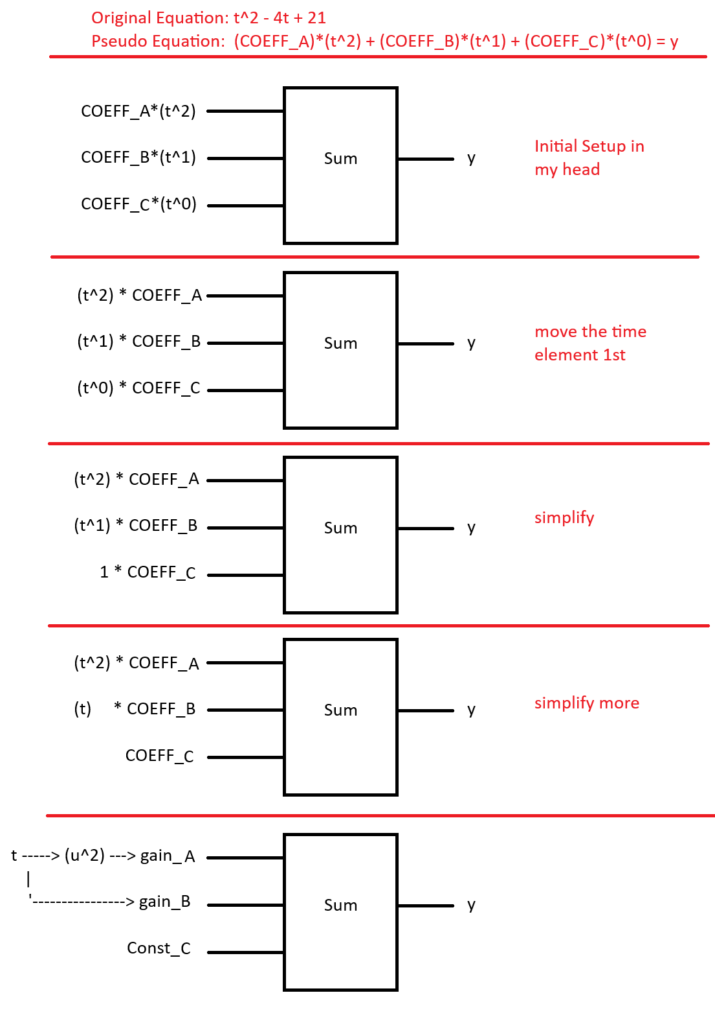
Original Equation
$y = t^{2}−4t+21$
I see $y=t^{2}−4t+21$, and I mentally decompose it into terms that become blocks.
What's going on in my head after I see original equation:
Step 1. $y =t^{2}−4t +21$ Original Equation
Step 2. $y =1∗t^{2}−4∗t^{1} +21∗t^{0}$ Rearrange the polynomial
Step 3. $y =\left(1\right)∗t^{2}+\left(−4\right)∗t^{1} +\left(21\right)∗t^{0}$ Add Parenthesis
Step 4. $y =\left(1\right) ∗\left(t^{2}\right) + \left(−4\right) ∗\left(t^{1}\right) + \left(21\right) ∗\left(t^{0}\right)$
Step 5. $y = \left(COEFF_A\right)∗\left(t^{2}\right) + \left(COEFF_B\right)∗\left(t^{1}\right) + \left(COEFF_C\right) ∗\left(t^{0}\right)$
COEFF_A = 1
COEFF_B = -4
COEFF_C = 21
Model Construction Logic:
Step 1: Calculate t²
Step 2: Calculate -4t
Step 3: Apply Constant Term (21)
Step 4: Sum All Terms
Step 5: Output y
See next page for final Simulink model.
See Slide 11 – 17 for more details
Converting an Equation into a Simulink Model
Important:
Gain Block = Multiplication
Output = Input × Gain

Slide 6
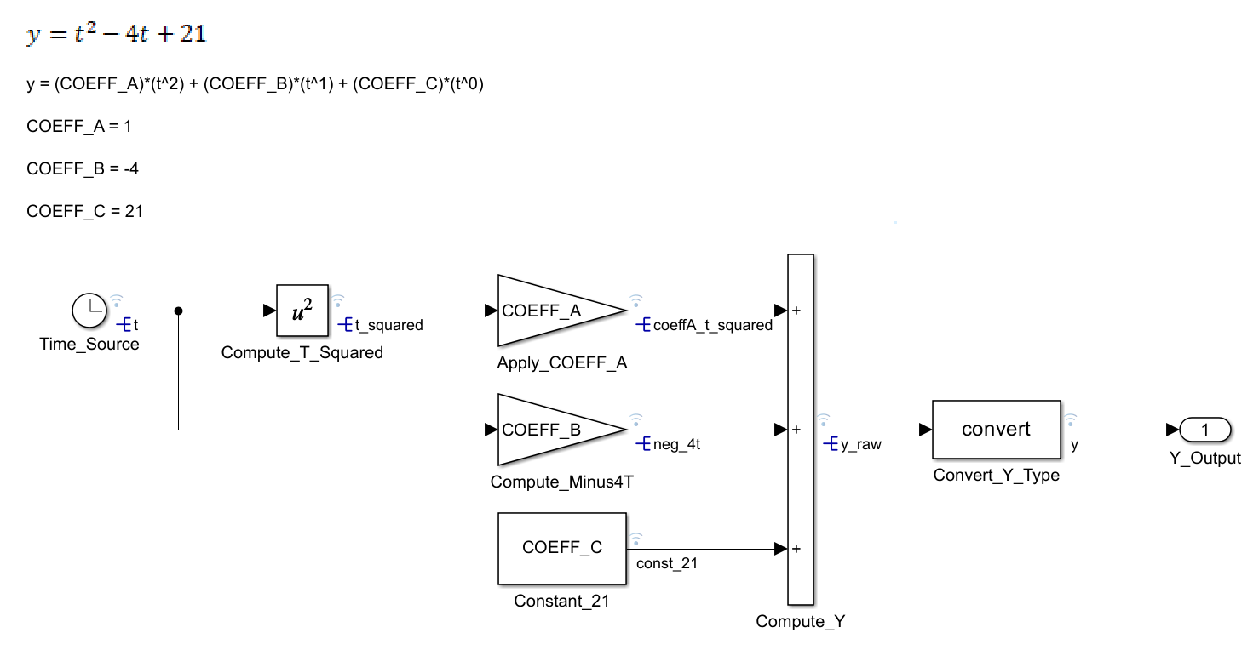
polynomial_System.slx (Model File)
Note: How your Model Should look when Finished
Final Setup

Slide 7
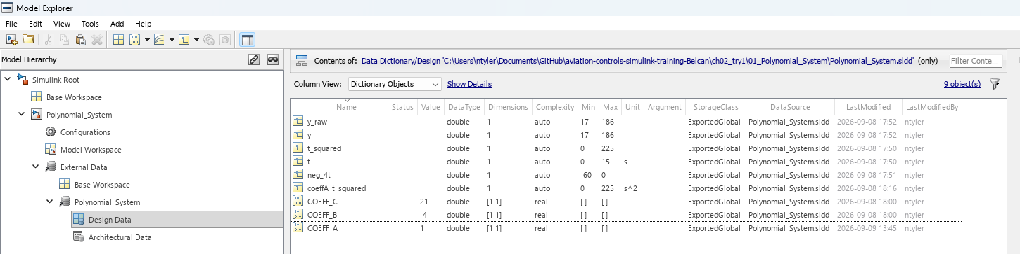
polynomial_System.sldd (Data Dictionary)
Note: Contains Signals & Parameters
Note: Contains Signals & Parameters
Final Setup
Name | Value | EntryType | DataType | Dimensions | Min | Max | Unit | Description
y_raw |  | Simulink.Signal | double | 1 | 17 | 186 |  | Intermediate polynomial result
y |  | Simulink.Signal | double | 1 | 17 | 186 |  | Polynomial output
t_squared |  | Simulink.Signal | double | 1 | 0 | 225 |  | Square of time
t |  | Simulink.Signal | double | 1 | 0 | 15 | s
neg_4t |  | Simulink.Signal | double | 1 | -60 | 0 |  | -4 multiplied by time
coeffA_t_squared |  | Simulink.Signal | double | 1 | 0 | 225 | s^2 | Coefficient A multiplied by the squared time term.
COEFF_C | 21 | Simulink.Parameter | double | [1 1] |  |  |  | Constant offset applied to the polynomial equation.
COEFF_B | -4 | Simulink.Parameter | double | [1 1] |  |  |  | Coefficient applied to the time term.
COEFF_A | 1 | Simulink.Parameter | double | [1 1] |  |  |  | Coefficient applied to the squared time term.

Slide 8
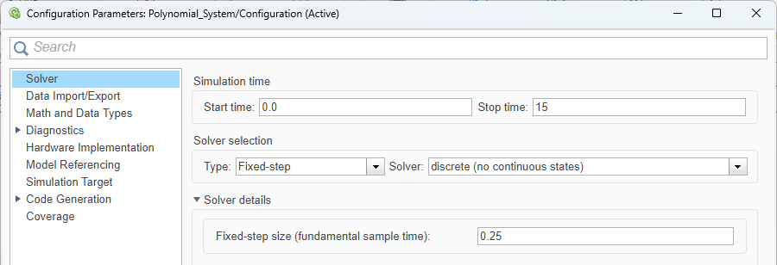
polynomial_System.slx (Model Settings)
Note: How you Models Settings should be setup.
Final Setup

Slide 9
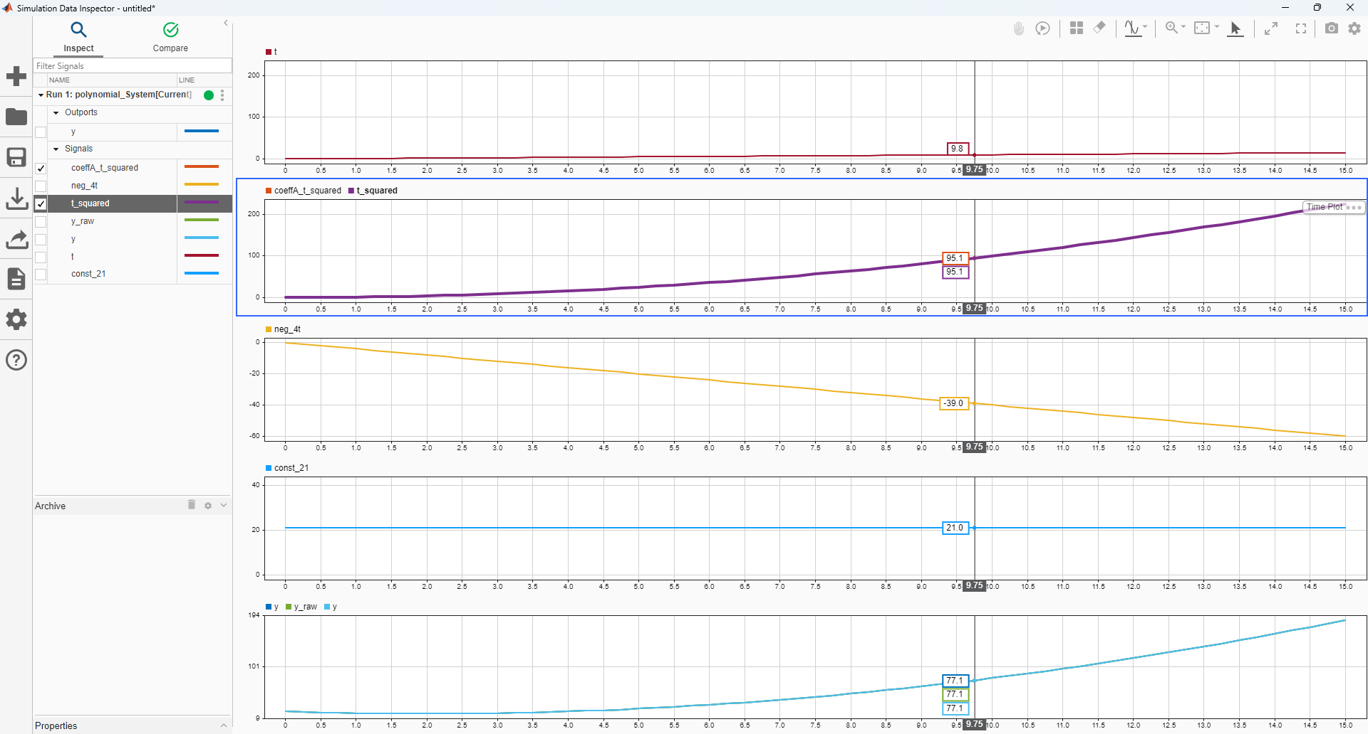
Data Inspector
Final Setup

Slide 10
How Engineers Think About Equations

Slide 11
How Engineers Think About Equations
How Engineers Think About Equations
Key Concept
Simulink models are graphical representations of mathematical operations. Engineers do not build the entire equation at once. They decompose it into smaller operations that can be implemented as blocks.
Example
$y = t^{2}− 4t + 21$
Identify Terms:
$t^{2}$
$−4t$
$21$
These terms will become the individual signal paths and mathematical operations used to construct the Simulink model shown on the next slide.
Equation
↓
Identify Terms
↓
Identify Operations
↓
Determine Data Flow
↓
Assign Simulink Blocks
↓
Connect Signals
↓
Generate Output
Mathematics Simulink Block
Addition (+) Sum
Subtraction (-) Sum
Multiplication (*) Gain / Product
Constant Value Constant
Power (t²) Math Function
Output (y) Outport
Important
Do not ask: "How do I build this model?“
Ask: "What mathematical operations make up this equation?“
This same process applies to:
Algebraic Equations Polynomial Equations Differential Equations
State Space Models Control Systems

Slide 12
Equation Decomposition
How Engineers Think About Equations
Original Equation
$y = t^{2}− 4t + 21$
Step 1: Split into Terms
$y =\left[t^{2}\right]+\left[− 4t\right] +\left[21\right]$
Step 2: Identify Operations
$t^{2}$ → Power
$−4t$ → Multiplication
$21$ → Constant
Assign Simulink Blocks
Each operation is implemented by one or more Simulink blocks.
Equation
↓
Identify Terms
↓
Identify Operations
↓
Determine Data Flow
↓
Assign Simulink Blocks
↓
Connect Signals
↓
Generate Output
Mathematical Term Simulink Block
$t^{2}$ Math Function
$−4t$ Gain Block
$21$ Constant Block
Addition Sum Block
Output y Outport
ENGINEERING RULE
Do not model the equation.
Model the mathematical operations that make up this equation.

Slide 13
From Mathematical Operations to Signal Flow
How Engineers Think About Equations
The goal is to understand how information (signals) moves through the model before selecting Simulink blocks.
Starting Variable
$t$
t
↓
------+------
↓ ↓
$t^{2}$ $−4t$
↓ ↓
------+------
↓
+$21$
↓
$$y$$
Signal Paths
Path 1: $t$ → $t^{2}$
Path 2: $t$ → $−4t$
Path 3: Constant $21$
Final Step:
Combine all three terms to produce y.
IMPORTANT
Before selecting blocks, understand how information must flow through the model. Signals represent data moving between mathematical operations.

Slide 14
Implementing Signal Flow Using Simulink Blocks
How Engineers Think About Equations
Signal Flow
Mathematical Operation → Simulink Block
Implementation Concept
t
↓
------+------
↓ ↓
$t^{2}$ $−4t$
↓ ↓
------+------
↓
+$21$
↓
$$y$$
Power (t²) → Math Function
Multiplication (-4t) → Gain
Constant (21) → Constant
Addition → Sum
Output (y) → Outport
Clock
↓
+ → Math Function → +
↓ ↓
+ → Gain (-4) → → →+ → Sum → y
↓ ↑
+ → Constant (21) → +
IMPORTANT
The mathematics has not changed. We are replacing each mathematical operation with a corresponding Simulink block.

Slide 15
Original Equation
$y = t^{2}−4t+21$
I see $y=t^{2}−4t+21$, and I mentally decompose it into terms that become blocks.
What's going on in my head after I see original equation:
Step 1. $y =t^{2}−4t +21$ Original Equation
Step 2. $y =1∗t^{2}−4∗t^{1} +21∗t^{0}$ Rearrange the polynomial
Step 3. $y =\left(1\right)∗t^{2}+\left(−4\right)∗t^{1} +\left(21\right)∗t^{0}$ Add Parenthesis
Step 4. $y =\left(1\right) ∗\left(t^{2}\right) + \left(−4\right) ∗\left(t^{1}\right) + \left(21\right) ∗\left(t^{0}\right)$
Step 5. $y = \left(COEFF_A\right)∗\left(t^{2}\right) + \left(COEFF_B\right)∗\left(t^{1}\right) + \left(COEFF_C\right) ∗\left(t^{0}\right)$
COEFF_A = 1
COEFF_B = -4
COEFF_C = 21
Model Construction Logic:
Step 1: Calculate t²
Step 2: Calculate -4t
Step 3: Apply Constant Term (21)
Step 4: Sum All Terms
Step 5: Output y
See next page for final Simulink model.
Converting an Equation into a Simulink Model
Important:
Gain Block = Multiplication
Output = Input × Gain

Slide 16
The model implements: y = t² - 4t + 21 (THIS IS THE FINAL IMPLIMENTATION)
Final Simulink Implementation

Slide 17
How to Open MATLAB & SIMULINK

Slide 18
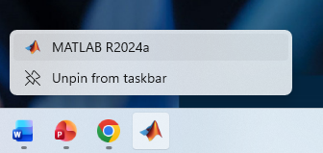
Open MATLAB
How to Open MATLAB & SIMULINK

Slide 19
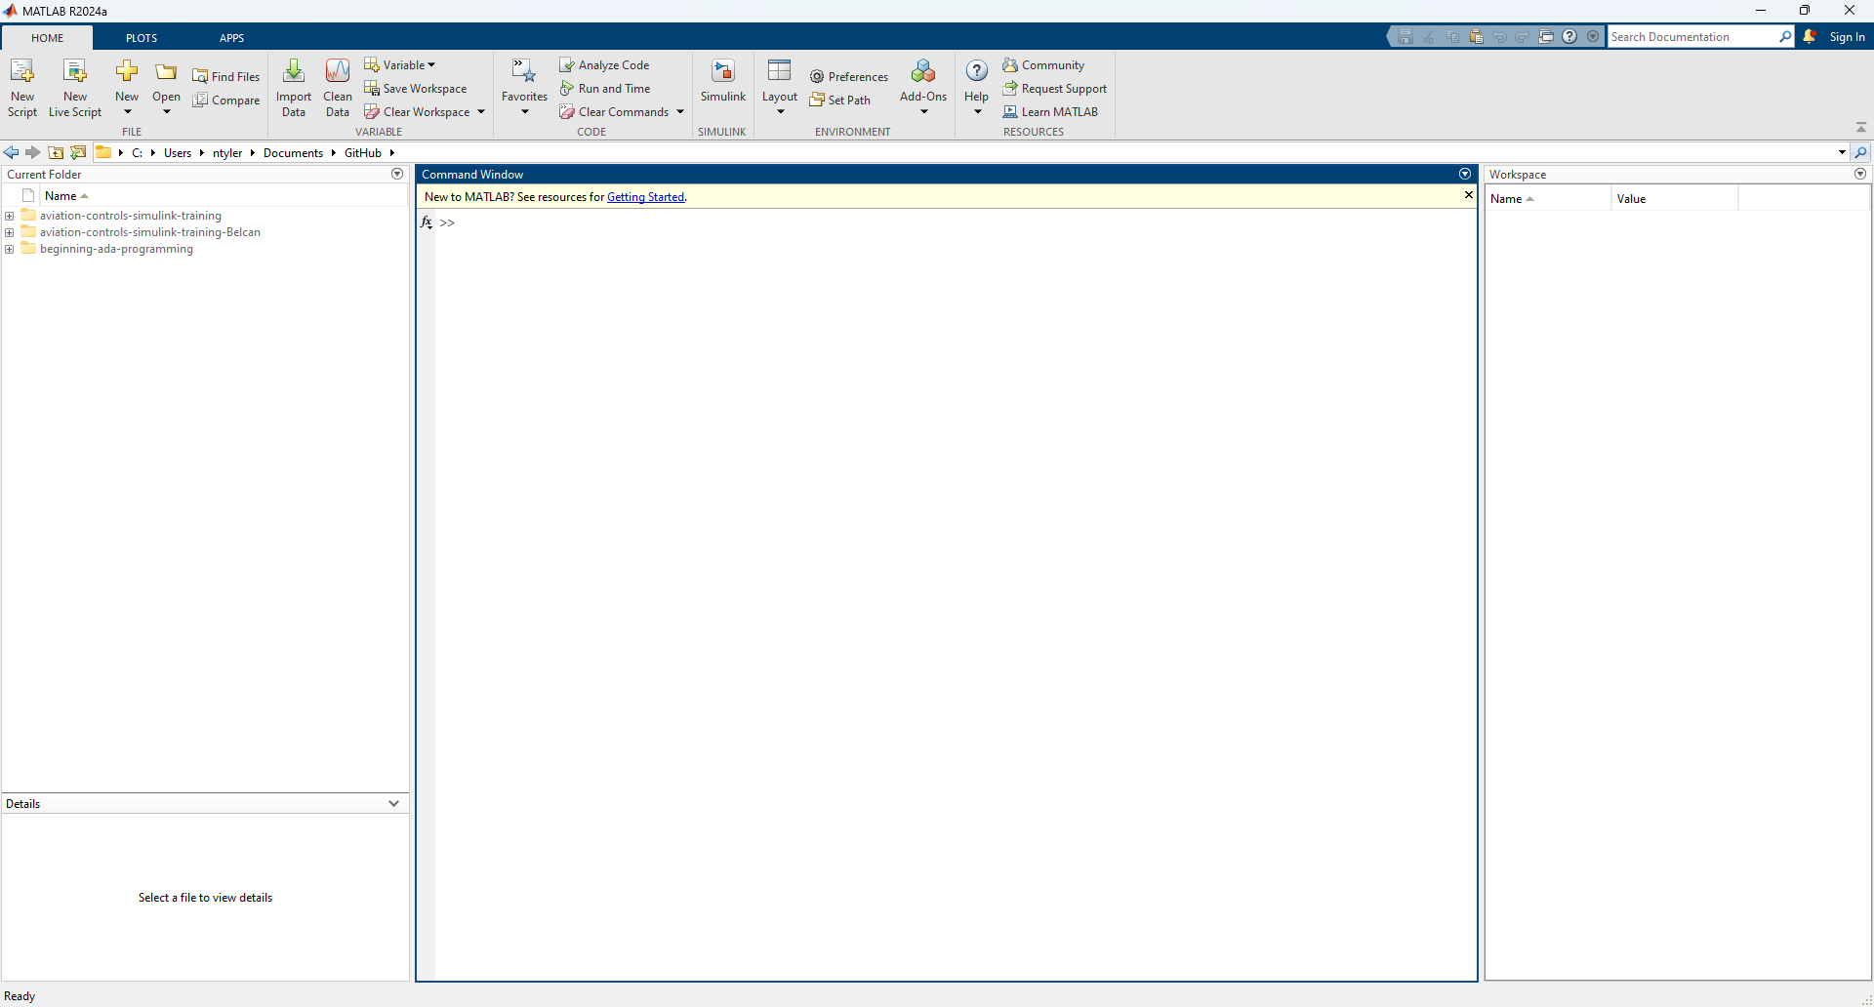
Review the MATLAB Window Layout
How to Open MATLAB & SIMULINK

Slide 20
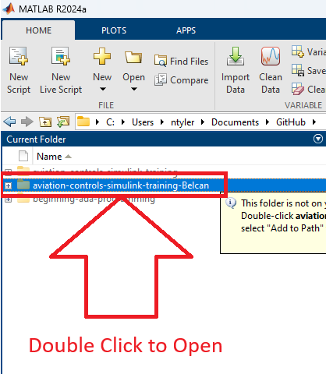
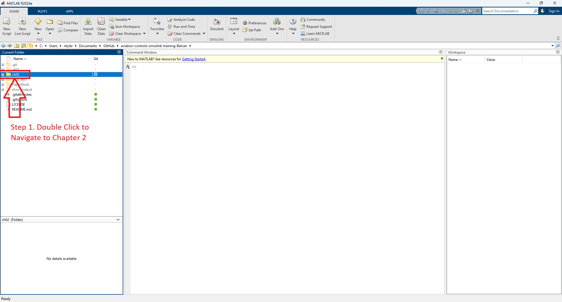
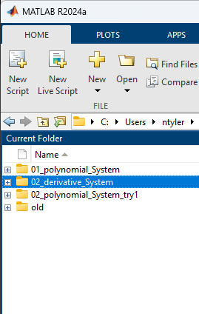
Navigate to training folder (Summary)
How to Open MATLAB & SIMULINK
Step 1. Navigate to training folder
Step 2. Navigate to Chapter 2 folder
Step 2. Navigate to sub folder “02_derivative_System”
Step 1. Double Click

Slide 21
How to Add To Project

Slide 22
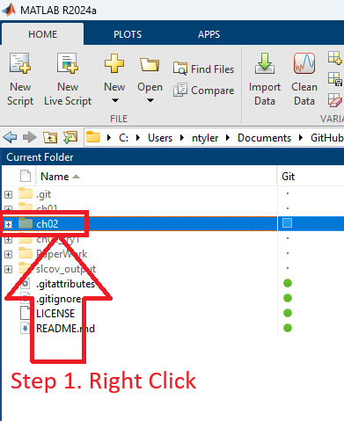
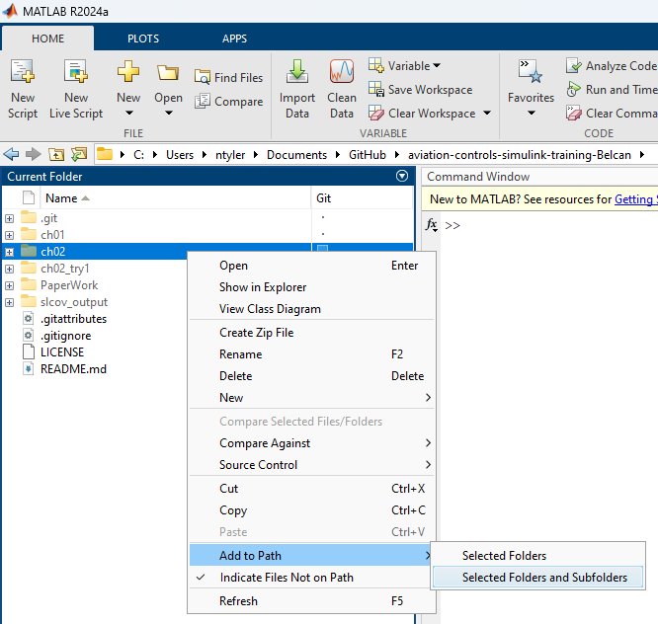

Add “ch02” Folder and Sub Folders to Project
How to Add To Project
Step 1. Right Click Folder
Step 2. Click “Add Selected Folders and Subfolders”
Step 3. Observe Folder has been added to path

Slide 23
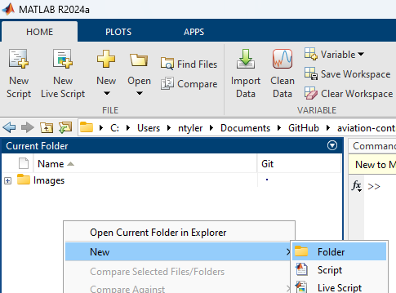
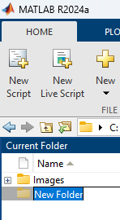
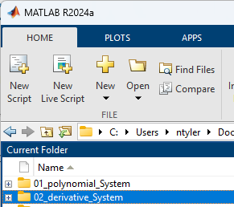
Create New Folder “02_derivative_System”
How to Add To Project
Step 1. Double Click ch02 Folder
Step 2. Right Click on Empty Space and Click “Folder”
Step 3.
Rename Folder
Step 4. Rename Folder to
02_derivative_System

Slide 24

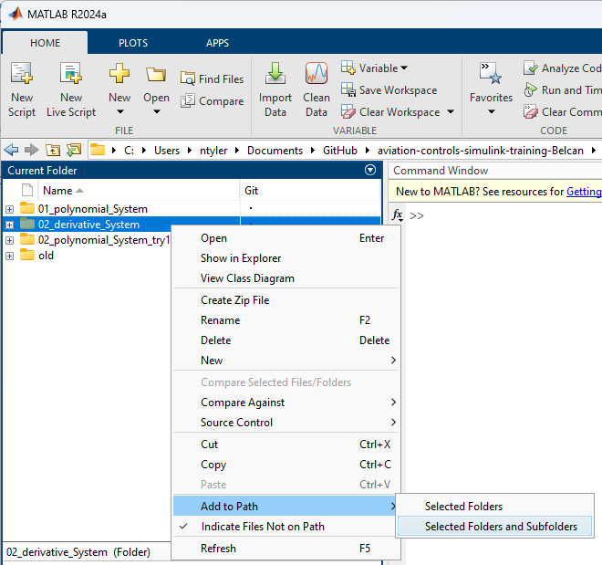
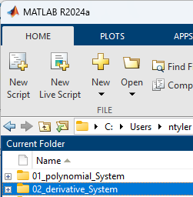
Add “02_derivative_System” Folder and Sub Folders to Project
How to Add To Project
Step 1. Right Click Folder
Step 2. Add Selected Folders and Subfolders
Step 3. Observe Folder has been added to path
Step 1. Right Click
Step 1. Observe folder has been added to path

Slide 25
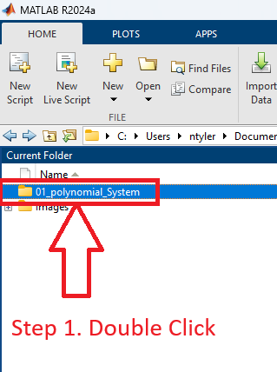
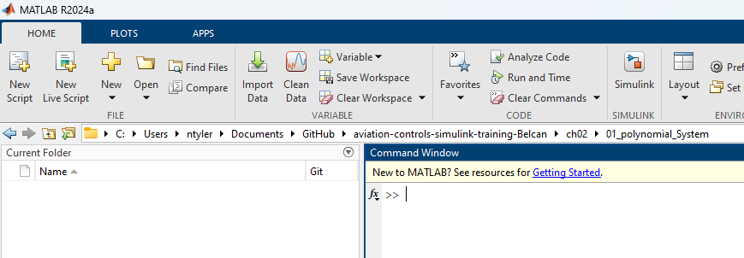
Navigate to training folder “02_derivative_System”
How to Add To Project
Step 1. Double Click Folder
Step 2. Observe Empty Folder

Slide 26
How to Create a new Simulink Model

Slide 27
Detailed Success in this section looks like knowing how to …
How to Create a new Simulink Model
Create a new Simulink Model
  Creating File (slx) Create / Rename / Open

Slide 28
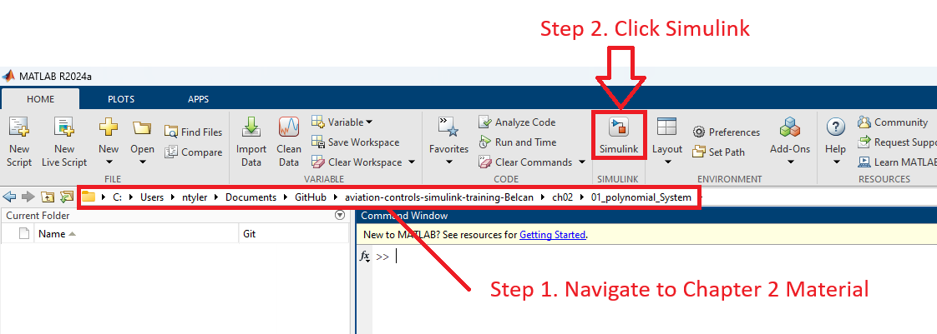
Navigate to training folder & create Simulink Model
How to Create a new Simulink Model

Slide 29
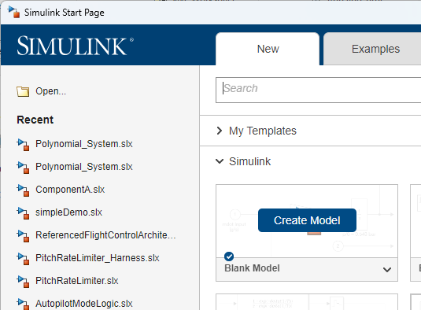
Navigate to training folder & create Simulink Model
How to Create a new Simulink Model
1) Click Create Model

Slide 30
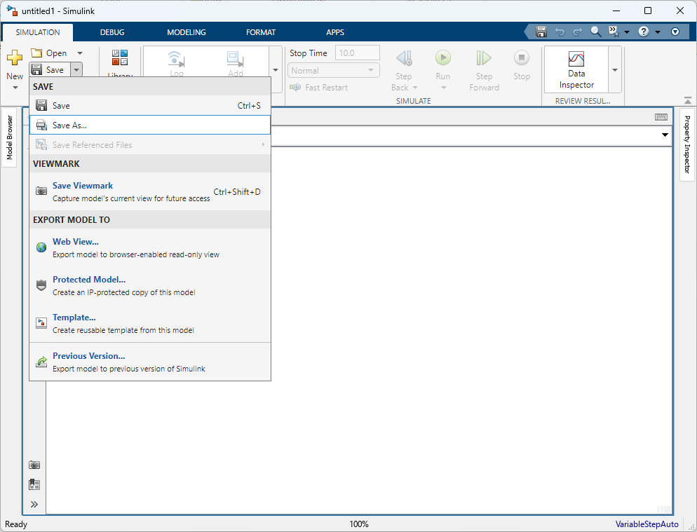
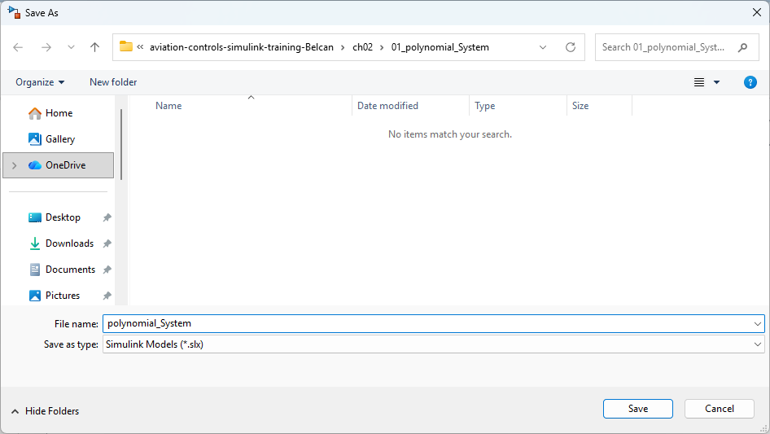
Rename Simulink File
How to Create a new Simulink Model
Step 1. Click Save
Step 2. Save As “polynomial_System”

Slide 31
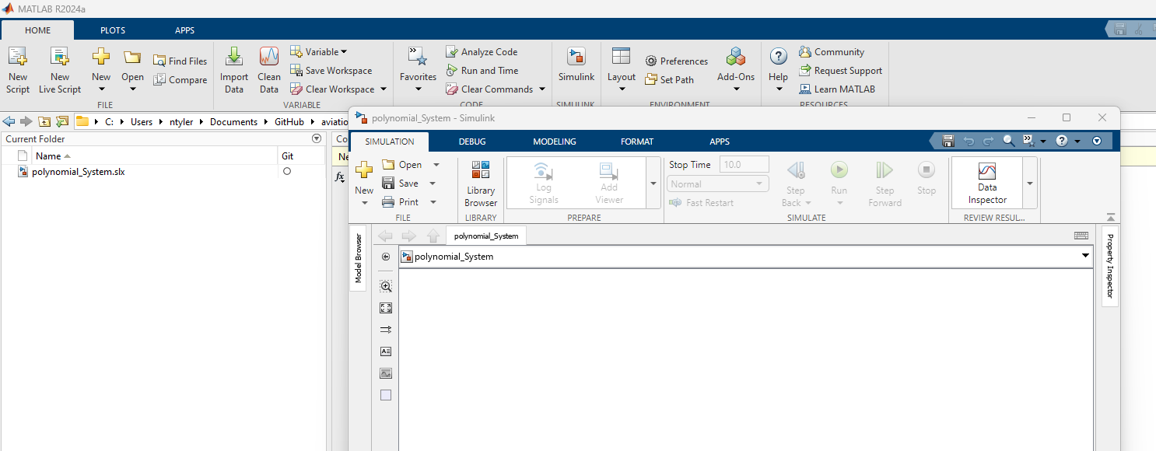
Observe File has been Renamed
How to Create a new Simulink Model

Slide 32
How to Use blocks

Slide 33
Detailed Success in this section looks like knowing how to …
How to Use blocks (Part 1)
Use blocks
  Blocks Add / Edit / Label
  Model Fit Contents to Window
  Lines Create / Edit / Format / Label / Data log / Resolve
  Signal Attributes View / Edit / Property Inspector

Slide 34
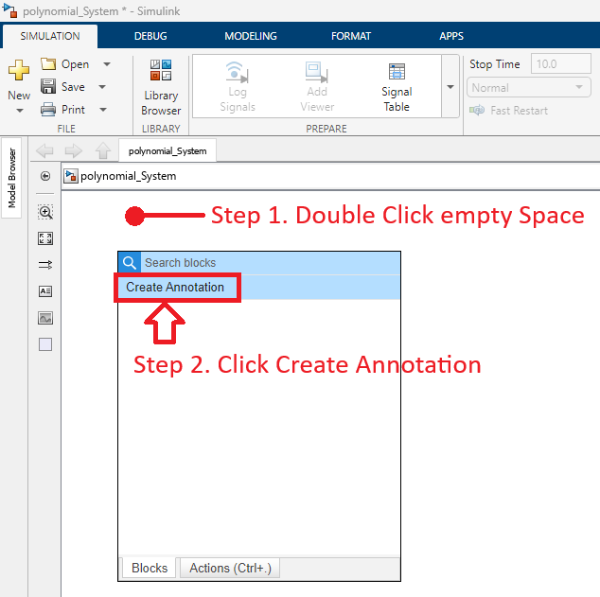
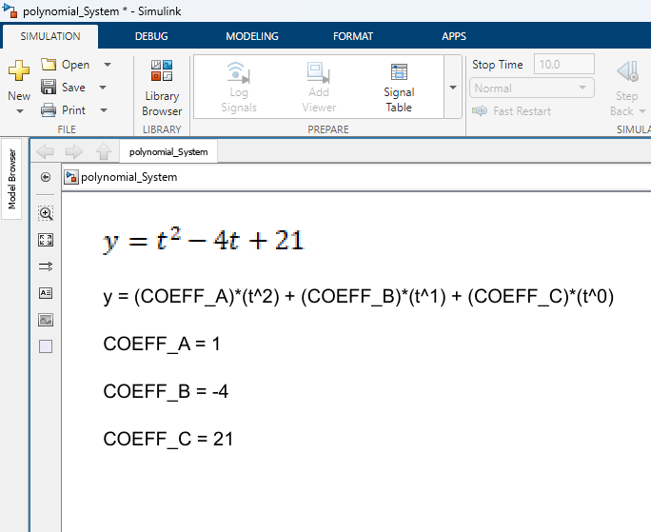
Add Annotation
How to Use blocks (Part 1)
Step 1. Double Click on Empty Space
Step 2. Type “step” and press enter

Slide 35
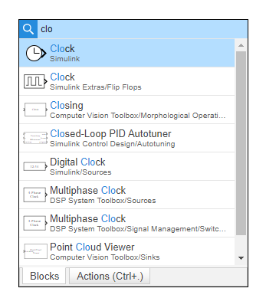
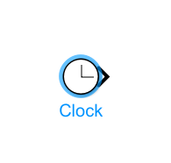
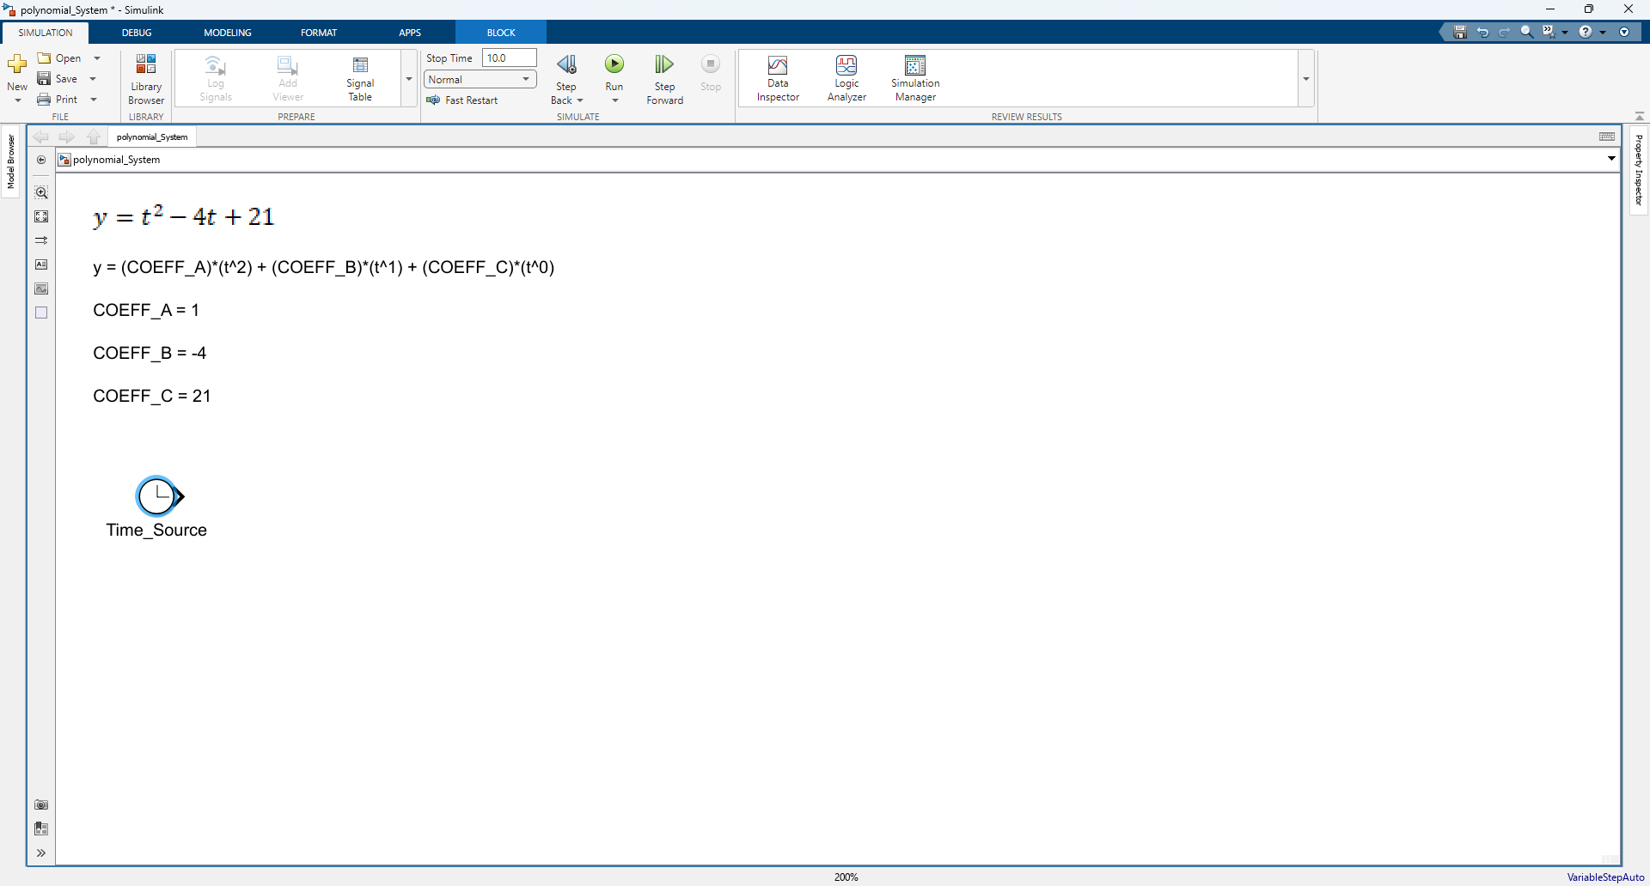
Add Clock
How to Use blocks (Part 1)
Step 1. Double Click empty space
Step 2. Add Clock
Step 3. Rename Clock
1. Type clo
2. Click
1. Click Block

Slide 36
Added Clock
How to Use blocks (Part 1)

Slide 37
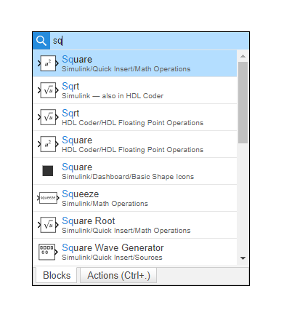
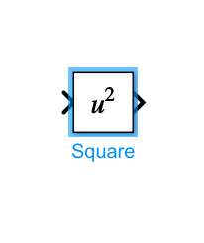
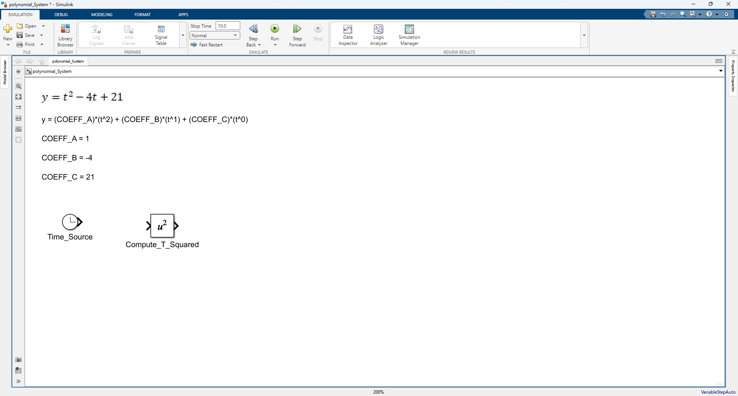
Add Square
How to Use blocks (Part 1)
Step 1. Double Click empty space
Step 2. Add Square
Step 3. Rename Square
1. Type sq
2. Click
1. Click Block

Slide 38
Added Square
How to Use blocks (Part 1)

Slide 39
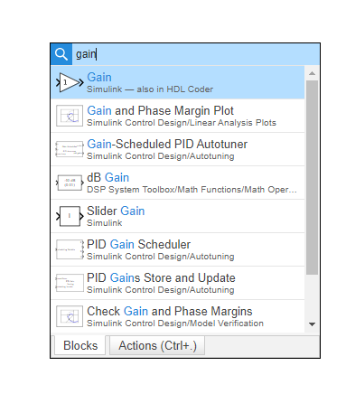
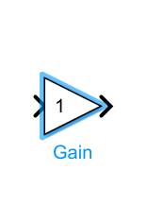
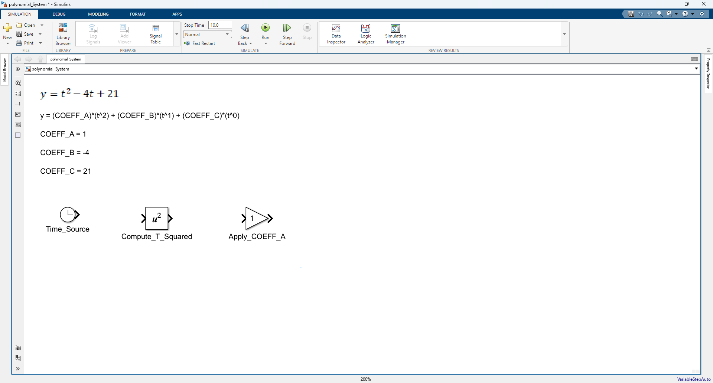
Add 1st Gain Block
How to Use blocks (Part 1)
Step 1. Double Click empty space
Step 2. Add Gain
Step 3. Rename Gain
1. Type gain
2. Click
1. Click Block

Slide 40
Added 1st Gain Block
How to Use blocks (Part 1)

Slide 41
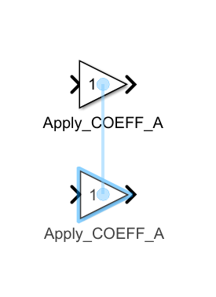
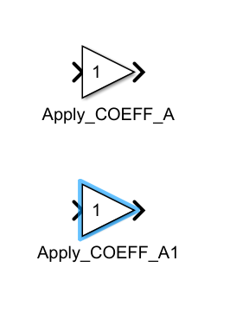
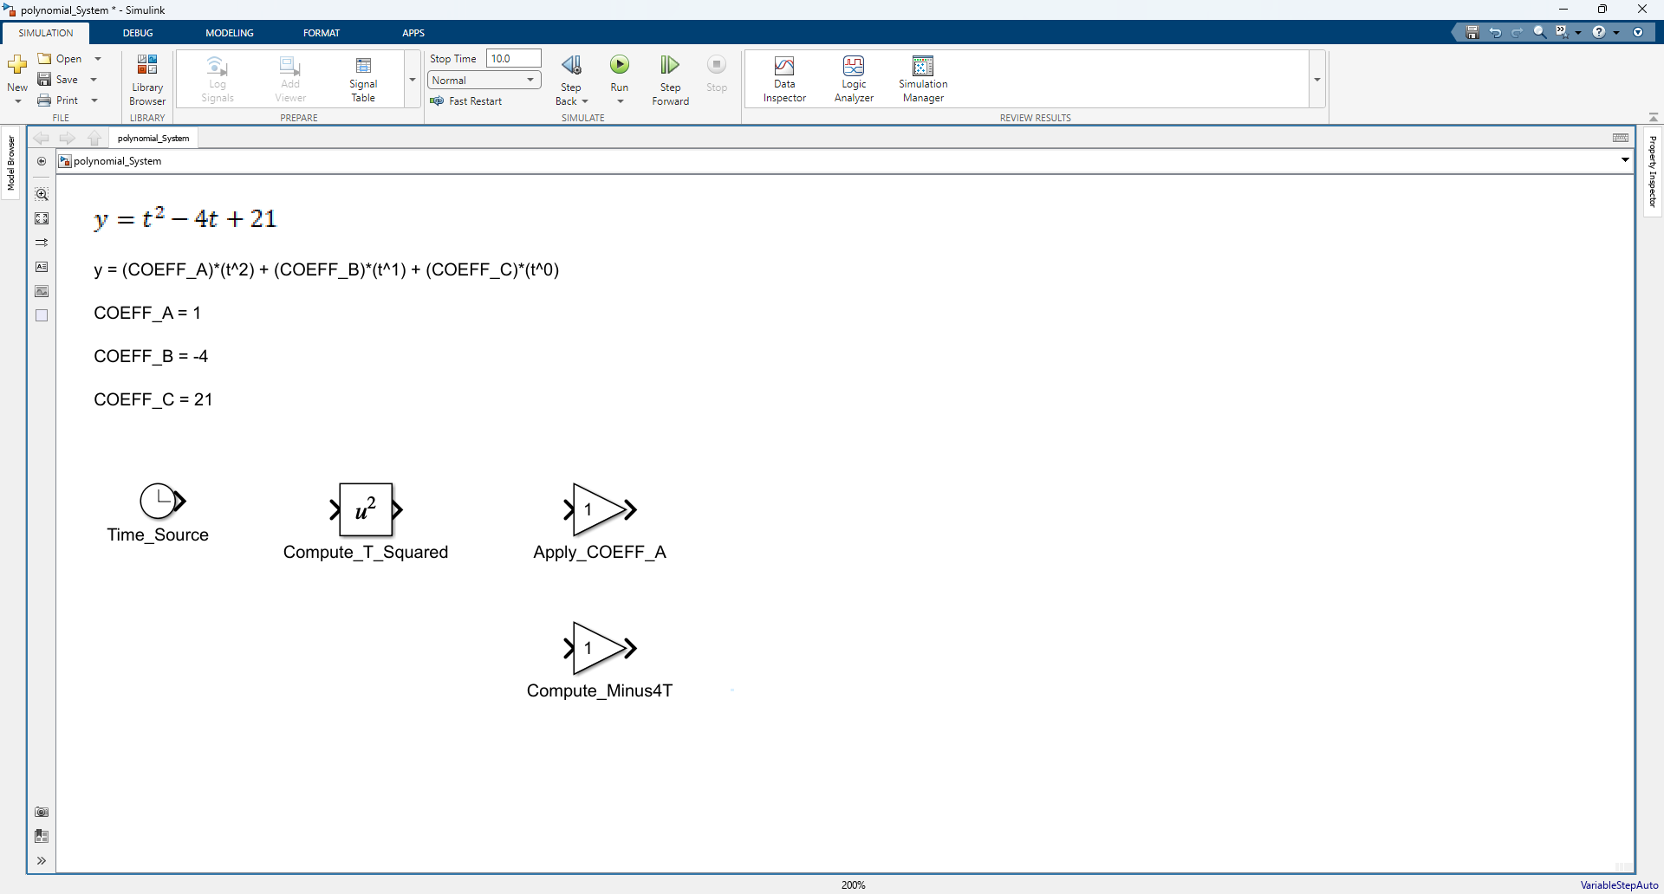
Add 2nd Gain Block
How to Use blocks (Part 1)
Step 1. Duplicate Gain block by Holding ctrl and Dragging gain block down
Step 2. Observe Duplication Result
Step 3. Rename Gain
Step 1. Hold ctrl and drag gain block down
Step 1. Observe New Gain block that was generated
Step 1. Rename Gain Block

Slide 42
Added 2nd Gain Block
How to Use blocks (Part 1)

Slide 43
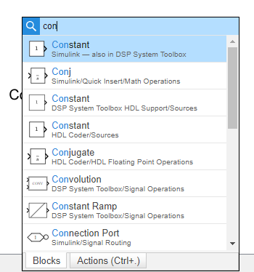
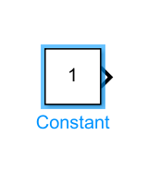
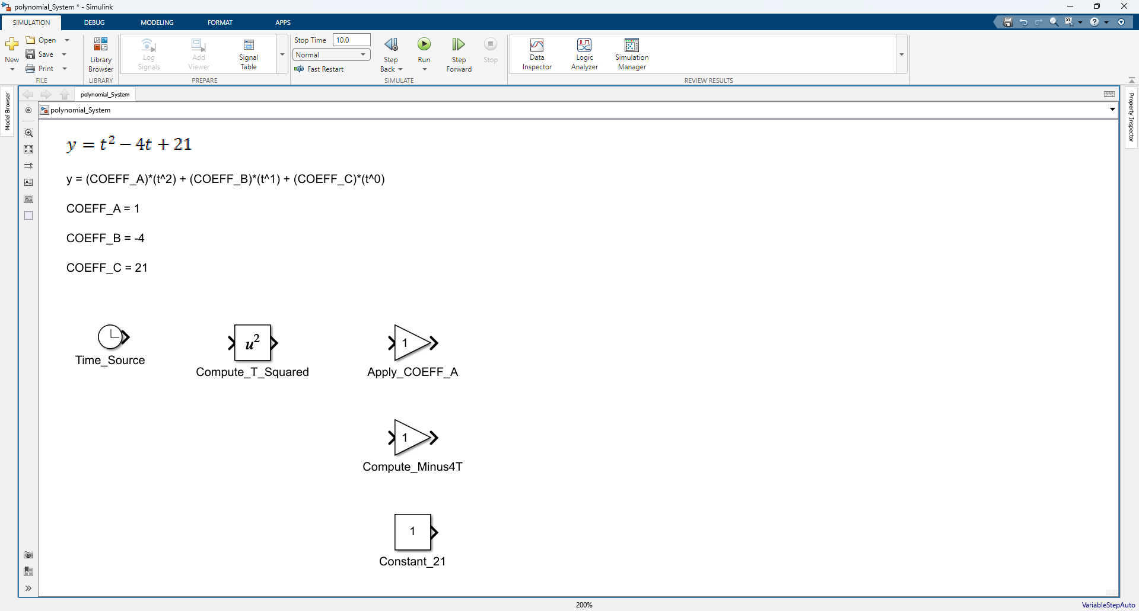
Add Constant Block
How to Use blocks (Part 1)
Step 1. Double Click empty space
Step 2. Add Constant Block
Step 3. Rename Constant Block
1. Type con
2. Click
1. Click Block

Slide 44
Added Constant Block
How to Use blocks (Part 1)

Slide 45
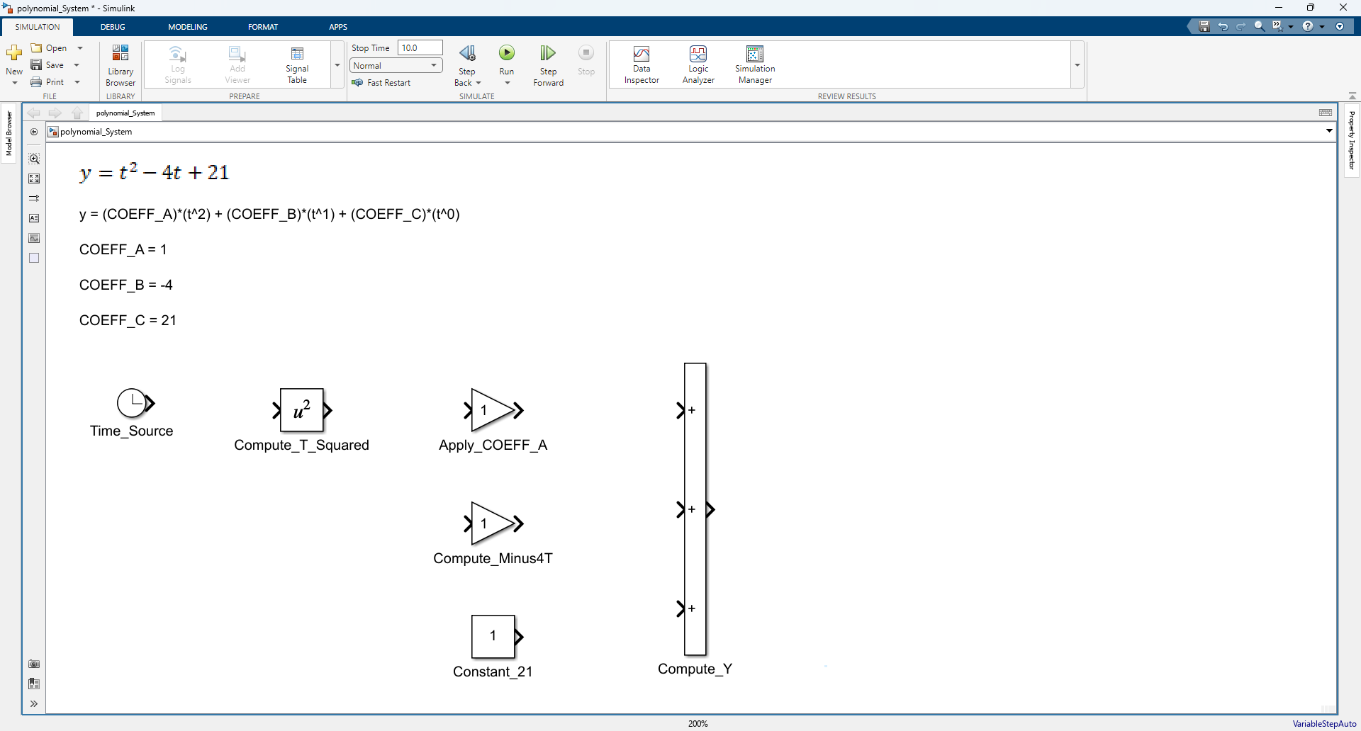
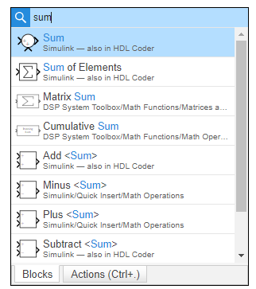
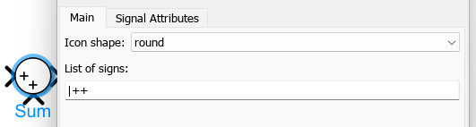
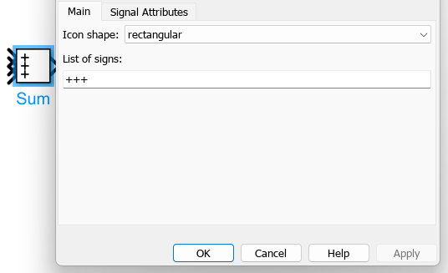
Add Sum Block
How to Use blocks (Part 1)
Step 1. Double Click empty space
Step 2. Add Sum Block & Edit Block Parameters
Step 3. Rename and resize Sum Block
1. Type sum
Step 1. Double Click Sum
2. Click
Step 2. Update Icon Shape “rectangular” & list signs “+++”
Step 3. Click Apply

Slide 46
Added Constant Block
How to Use blocks (Part 1)

Slide 47
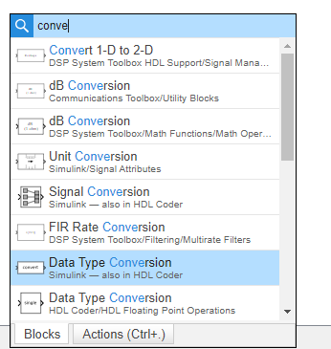
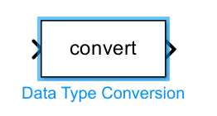
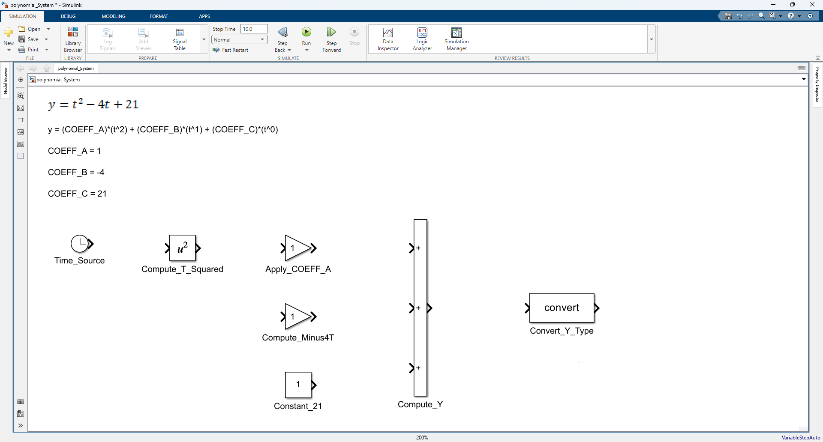
Add Data Type Conversion Block
How to Use blocks (Part 1)
Step 1. Double Click empty space
Step 2. Add Data Type Conversion
Step 3. Rename Data Type Conversion
1. Type conve
1. Click Block
2. Click

Slide 48
Added Data Type Conversion Block
How to Use blocks (Part 1)

Slide 49
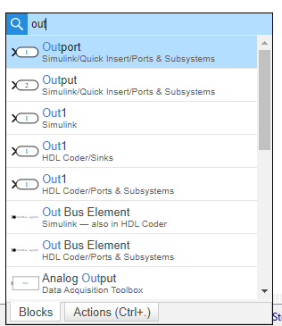
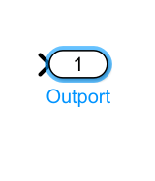

Add Outport Block
How to Use blocks (Part 1)
Step 1. Double Click empty space
Step 2. Add Outport
Step 3. Rename Outport
1. Type out
2. Click
1. Click Block

Slide 50
Added Outport Block
How to Use blocks (Part 1)

Slide 51

Add Signal Lines
How to Use blocks (Part 1)

Slide 52

Align Blocks
How to Use blocks (Part 1)

Slide 53


Show Property Inspector (Method 1)
Note: This is my preferred method
How to Use blocks (Part 1)
Step 1. Click Property Inspector
Step 2. Click Down Arrow and then Click Restore

Slide 54


Show Property Inspector (Method 2)
Note: This method will force property Inspector to activate
How to Use blocks (Part 1)
Step 1. Click “MODELING” Tab and expand options
Step 2. Click Property Inspector

Slide 55


Update Signal: t
How to Use blocks (Part 1)
Step 1. Select Line and Update Signal Name
Step 2. Check Boxes
Step 1. Check Boxes
Step 1. Select Line
Step 2. Observe

Slide 56


Update Signal: t_squared
How to Use blocks (Part 1)
Step 1. Select Line and Update Signal Name
Step 2. Check Boxes
Step 1. Check Boxes
Step 1. Select Line
Step 2. Observe

Slide 57


Update Parameter: COEFF_A
How to Use blocks (Part 1)
Step 1. Select Line and Update Parameter Name
Step 2. Observe renamed parameter
Step 1. Check Boxes
Step 1. Select Block
Step 2. Observe

Slide 58



Format Blocks to Same Size
Note: The last block you select is used as the formatting reference. All other selected blocks will be formatted to match it.
How to Use blocks (Part 1)
Step 1. Select Blocks
Step 2. Select Final Block
Step 3. Format Blocks
Step 1. Click Match
Step 1. Shift Hold Select Block
Step 2. Observe
Step 1. Select Blocks

Slide 59

Format Blocks to Same Size
Note: The last block you select is used as the formatting reference. All other selected blocks will be formatted to match it.
How to Use blocks (Part 1)
Step 1. Select Blocks
Step 2. Observe Aligned Blocks
Step 1. Click Align
Step 2. Shift Hold Select Block
Step 2. Observe
Step 1. Select Blocks

Slide 60


Update Parameters: COEFF_B & COEFF_C
How to Use blocks (Part 1)
Step 1. Update Gain block
Step 2. Update Constant Block

Slide 61


Update Signal: coeffA_t_squared
How to Use blocks (Part 1)
Step 1. Select Line and Update Signal Name
Step 2. Check Boxes
Step 1. Check Boxes
Step 1. Select Line
Step 2. Observe

Slide 62


Update Signal: neg_4t
How to Use blocks (Part 1)
Step 1. Select Line and Update Signal Name
Step 2. Check Boxes
Step 1. Check Boxes
Step 1. Select Line
Step 2. Observe

Slide 63


Update Signal: const_21
How to Use blocks (Part 1)
Step 1. Select Line and Update Signal Name
Step 2. Check Boxes
Step 1. Check Boxes
Step 1. Select Line
Step 2. Observe

Slide 64


Update Signal: y_raw
How to Use blocks (Part 1)
Step 1. Select Line and Update Signal Name
Step 2. Check Boxes
Step 1. Check Boxes
Step 1. Select Line
Step 2. Observe

Slide 65


Update Signal: y
How to Use blocks (Part 1)
Step 1. Select Line and Update Signal Name
Step 2. Check Boxes
Step 1. Check Boxes
Step 1. Select Line
Step 2. Observe

Slide 66


Save Model File
How to Use blocks (Part 1)
Step 1. Click Save (* indicates the file is unsaved)
Note: ctrl + s will also save the document
Step 2. Observe the Saved File

Slide 67
How to Use Model Configuration

Slide 68
Detailed Success in this section looks like knowing how to …
How to Use Model Configurations
Use blocks
  Model Settings Edit

Slide 69
Update Model Configurations (Part 1)
How to Use Model Configurations
Step 1. Click Model Settings
Step 2. Observe the opened Model Configuration.

Slide 70
Update Model Configurations (Part 2)
How to Use Model Configurations
Step 1 Update Model Configuration Settings
Step 2. Observe Stop time after clicking apply
Step 1. Set Type to 15
Step 3. Set Solver to discrete
Step 1. Observe Stop Time was Updated
Step 4. Set Fixed-step size to 0.25
Step 2. Set Type to Fixed-step
Step 5. Click Apply

Slide 71
Save Model File
How to Use Model Configurations
Step 1. Click Save (* indicates the file is unsaved)
Note: ctrl + s will also save the document
Step 2. Observe the Saved File

Slide 72
How to Use Model Explorer

Slide 73
Detailed Success in this section looks like knowing how to …
How to Use Model Explorer
Use Model Explorer
  Data Dictionary (sldd) Create / Edit

Slide 74
Open Model Explorer
How to Use Model Explorer
Step 1. Click “MODELING” Tab and Click “Model Explorer”
Step 2. Observe Model Explorer Window
Step 1. Click “MODELING” Tab
Step 2. Click “Model Explorer”

Slide 75
Create Data Dictionary File (.sldd)
How to Use Model Explorer
Step 1. Drill Down to “External Data” and then Click “New”
Step 1. Drill Down to “External Data”
Step 2. Click New to create a new data dictionary

Slide 76

Create Data Dictionary File (.sldd)
How to Use Model Explorer
Step 1. Save file as “polynomial_System”
Step 2) Apply Changes
Step 1. Create File polynomial_System.sldd
Step 1. Observe our created file polynomial_System.sldd
This will hold our signal definitions and more .
Step 2. Click Save
Step 2. Click Apply

Slide 77
Open Design Data
How to Use Model Explorer
Step 1. Click “polynomial_System”
Step 2. Drill down to Design Data
Step 3. Observe Design Data
Step 1. Click
Step 1. Expand
Step 2. Click

Slide 78
Add Simulink Signal
Note: Just Create the blank signal for now
How to Use Model Explorer
Step 1. Click “Simulink Signal” x6
Note: This will add a new signal to your data inspector.
Step 1. Click “Simulink Signal”
Repeat Action x6

Slide 79
Add Simulink Parameter
Note: Just Create the blank parameter for now
How to Use Model Explorer
Step 1. Click “Simulink Parameter” x3
Note: This will add a new signal to your data inspector.
Step 1. Click “Simulink Parameter”
Repeat Action x3

Slide 80
Rename Signals and Parameters
How to Use Model Explorer
Step 1. Click each row and update the Name of each signal and parameter
Note: This will add a new signal to your data inspector.
Step 1. Update Names
Step 2. Observe Columns prior to Update (Next 3 slides will update these columns)

Slide 81
Mass Update Data Type
Note: Mandatory
How to Use Model Explorer
Step 1. Shift + Hold + select rows
Step 2. Click & Update Field
Step 3. Observe updated column
Step 1. Observe Data Type Before Update is “auto”
1. Click field
2. Select
Step 1. Observe Data Type After Update is “double”

Slide 82
Mass Update Dimensions
Note: Optional
How to Use Model Explorer
Step 1. Shift + Hold + select rows
Step 2. Click & Update Field
Step 3. Observe updated column
Step 1. Observe Dimensions Before Update is -1 or [0 0]
Step 1. Click field
Step 2. Type 1
Step 1. Observe Dimensions After Update is 1 or [1 1]

Slide 83
Mass Update Storage Class
Note: Optional
How to Use Model Explorer
Step 1. Shift + Hold + select rows
Step 2. Click & Update Field
Step 3. Observe updated column
Step 1. Observe Storage Class Before Update is auto
1. Click field
2. Select
Step 1. Observe Storage Class After Update is ExportedGlobal

Slide 84
Observe Data Dictionary After Mass Update
How to Use Model Explorer
Step 1. Observe Updated Columns
Step 1. Observe Updated Columns

Slide 85
Update Signal: y_raw
How to Use Model Explorer
Step 1. Select Signal and Update remaining fields
Step 1. Select signal
Step 2. Update Min, Max, & Description

Slide 86
Update Signal: y
How to Use Model Explorer
Step 1. Select Signal and Update remaining fields
Step 1. Select signal
Step 2. Update Min, Max, & Description

Slide 87
Update Signal: t_squared
How to Use Model Explorer
Step 1. Select Signal and Update remaining fields
Step 1. Select signal
Step 2. Update Min, Max, & Description

Slide 88
Update Signal: t
How to Use Model Explorer
Step 1. Select Signal and Update remaining fields
Step 1. Select signal
Step 2. Click & Update fields Min, Max, & Unit

Slide 89
Update Signal: neg_4t
How to Use Model Explorer
Step 1. Select Signal and Update remaining fields
Step 1. Select signal
Step 2. Click & Update fields Min & Max
Step 3. Update Description

Slide 90
Update Signal: coeffA_t_squared
How to Use Model Explorer
Step 1. Select Signal and Update remaining fields
Step 1. Select signal
Step 2. Click & Update fields Min, Max, & Unit
Step 3. Update Description

Slide 91
Update Parameter: COEFF_C
How to Use Model Explorer
Step 1. Select Signal and Update remaining fields
Step 1. Select Param
Step 2. Update Value
Step 3. Update Description

Slide 92
Update Parameter: COEFF_B
How to Use Model Explorer
Step 1. Select Signal and Update remaining fields
Step 1. Select Param
Step 2. Update Value
Step 3. Update Description

Slide 93

Update Parameter: COEFF_A
How to Use Model Explorer
Step 1. Select Signal and Update remaining fields
Step 1. Select Param
Step 2. Update Value
Step 3. Update Description

Slide 94


Save Changes made to Data Dictionary (.sldd)
Note: Changes made to the data dictionary must be saved from Model Explorer. Otherwise, the changes will not be applied and may be lost.
Note: Pressing Ctrl+S in Model Explorer does not save data dictionary changes. Instead, it may create a new signal or have a different action than expected. To save dictionary changes, right-click the data dictionary and select Save Changes. Yes, this behavior surprises everyone at least once.
How to Use Model Explorer
Step 1. Click polynomial_System*
Step 2. Right Click & Save Changes
Step 3. Observe Saved File
1. Click
1. Right Click
2. Click Save

Slide 95
Save Model File
How to Use Model Configurations
Step 1. Click Save (* indicates the file is unsaved)
Note: ctrl + s will also save the document
Step 2. Observe the Saved File

Slide 96
How to Run a simulation

Slide 97
Detailed Success in this section looks like knowing how to …
How to Run a simulation
Run a simulation
  Run Shortcut (CTRL+T)
  Stop Time Value is 15 sec

Slide 98

Run Simulation
How to Run a simulation
Step 1. Click Run or press CTRL+T
1. Click Tab “SIMULATION”
2. Click Run or press CTRL+T

Slide 99
How to Use Data inspector

Slide 100
Detailed Success in this section looks like knowing how to …
How to Use Data inspector
Use Data inspector
  Graph Graph Data / Edit Grid / Use Cursors
  Stop Time Value is 15 sec

Slide 101
Open Data Inspector
Note: Simulation must be run prior to opening Data inspector to observe raw values.
How to Use Data inspector
Step 1. Click Data Inspector
1. Click Tab “SIMULATION”
2. Click Data Inspector

Slide 102

Setup Data Inspector
How to Use Data inspector

Slide 103
Add Cursor
How to Use Data inspector

Slide 104


Save Data Inspector File
How to Use Data inspector
Click Save Icon
Click Save / Save As
Save File

Slide 105
▶ Launch Quiz

Slide 106


Relaunch the add-in
Microsoft Power BI
After you install the add-in, you can launch it by choosing the add-in button on the Home tab
On the Home tab
Home
Add-ins
Need more help?
Return to your internet browser or copy this link into your browser:
https://pages.store.office.com/addinsinstallpage.aspx?rs=en-US&assetid=WA200003233&isWac=True&ui=en-US&ad=US

Slide 107

Microsoft Power BI Test Results

Slide 108
Admin Only Links
Only the Admin uses these links
Quiz – Summary Page METRICS for Mike and Brandon
Quiz – Responses Overview
Quiz – Excel Log
My files – OneDrive Where Excel Log is stored
Power BI – Workspace My workspace
Power BI – Semantic Model Training Quiz Results Master Power Queries
Power BI – Results Training Performance Dashboard Power BI Dashboard

